Slide 1


ARTIFICIAL
INTELLIGENCE
Title: TumorTrace: MRI-Based AI for Breast Cancer Detection
Name: Shalem Bakth Singh
Theme : AI
Platform : Infosys Springboard
Mentor: Anurag Sista

Slide 2

PROJECT OVERVIEW
Objective:
• Build a machine learning model to classify breast cancer status (benign or malignant) using MRI images.
Goal:
• Aid in the early detection of breast cancer to improve patient outcomes.
Approach:
• Utilize deep learning models, data preprocessing, and evaluation matrices to predict tumor status

Slide 3

PROBLEM STATEMENT
The Problem:
Breast cancer is a major cause of mortality among women globally.
Timely detection is crucial for increasing survival chances but poses challenges.
Analyzing MRI scans manually is time-intensive, expensive, and error-prone.
The Need:
Develop an automated system for fast and accurate classification of MRI scans to enhance early and reliable cancer detection.
Create a machine learning model to classify MRI images as benign or malignant with high precision.
Support early detection and diagnosis of breast cancer, improving patient outcomes.

Slide 4

METHODOLOGY
Overview:
Collecting and organizing MRI image datasets.
Preprocessing data to ensure compatibility with the machine learning model.
Training and evaluating the model for accurate classification of MRI scans.
Steps:
Data Collection: Gather labeled MRI datasets with benign and malignant cases.
Data Preprocessing: Prepare the data by resizing images, normalizing pixel values, and applying data augmentation techniques.
Model Development: Build and train deep learning models such as VGG16 and ResNet for classification.
Evaluation: Measure model performance using metrics like accuracy, precision, recall, and F1 score.

Slide 5

DATA COLLECTION AND PREPROCESSING
Dataset:
Dataset contains MRI images labeled as either benign or malignant.
Source of Dataset : https://www.sciencedirect.com/science/article/abs/pii/S0010482523007205
Preprocessing Steps:
Grayscale Conversion: Convert MRI images to grayscale for simplified analysis.
Resizing: Standardize image dimensions (e.g., 224x224) for consistent model input.
Normalization: Scale pixel values to a suitable range (e.g., 0-1) for neural networks.
Augmentation: Enhance the dataset with techniques like rotation, flipping, and zooming.
Handling Class Imbalance: Address imbalance using methods such as oversampling, undersampling, or class weighting.

Slide 6
MODELS USED AND DEVELOPMENT
Models:
VGG16: A convolutional neural network with 16 layers.
ResNet18 and ResNet50: Deeper architectures using residual connections for improved training.
Model Selection:
VGG16: Chosen for its simplicity and effectiveness in image classification.
ResNet18 & ResNet50: Chosen for better performance in deeper layers with residual learning.
Development Steps:
Initialize Pre-trained Models: Load pre-trained models like VGG16 and ResNet with weights from large datasets (e.g., ImageNet).
Fine-tune on Breast Cancer Dataset: Adapt the pre-trained models by re-training on the specific breast cancer MRI dataset.
Train and Validate Models: Perform training and validate the models using the prepared dataset to optimize performance.

Slide 7
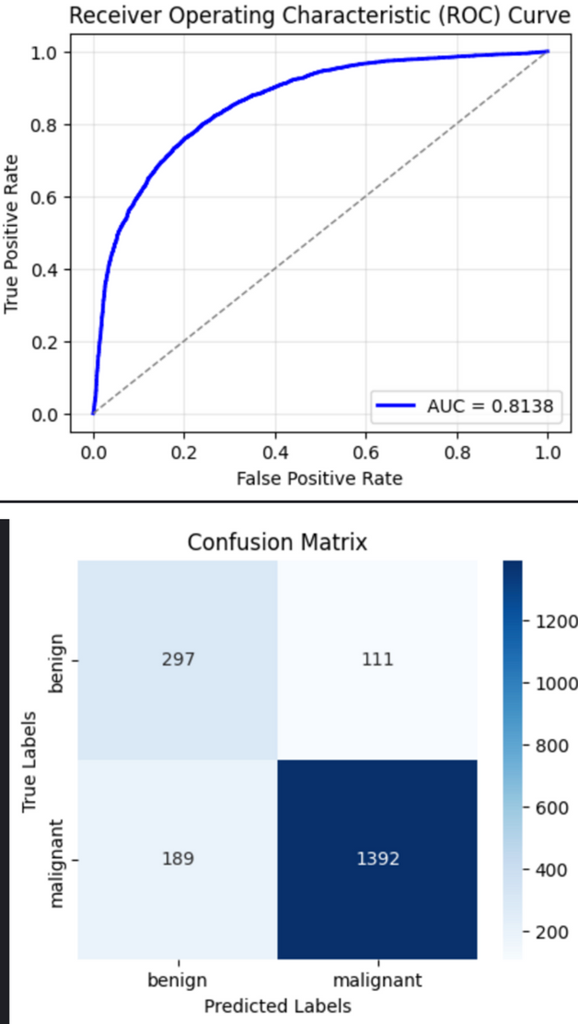

RESULTS AND IMPACT
Your paragraph text
Accuracy: 81%, AUC: 0.8663
Specificity: 1.0000, Sensitivity: 0.0000
Test Results:
Average Loss: 0.6204
Accuracy: 77.74% (5326/6851)
RECORDING
Click here https://drive.google.com/file/d/17ldH8KkjTBgEx4INtaZlwFi2BxDSf87J/view?usp=sharing

Slide 8
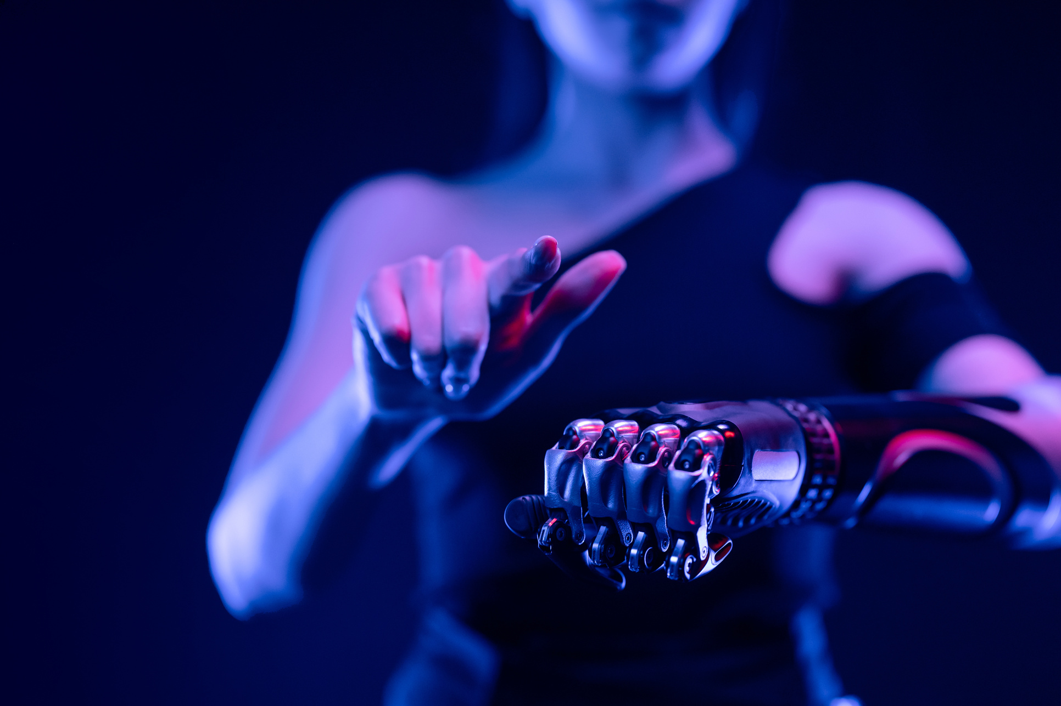
EVALUATION METRICS
Accuracy: Percentage of correct predictions.
Precision: Ability of the model to avoid false positives.
Recall: Ability of the model to identify actual positive cases (sensitivity).
F1 Score: Harmonic mean of precision and recall.
AUC (Area Under Curve): Measures how well the model
distinguishes between benign and malignant tumors.
Confusion Matrix: Table that helps you understand the performance of your classification. It shows the counts of true positives. true negatives, false positives, and false negatives

Slide 9
THANK YOU!

